Slide 1
Consensus Stability of Community Notes on X
Alexander He
Konstanz, 06.05.2026

Slide 2



Authors:
Yuwei Chuai (post doc researcher)
Gabriele Lenzini (Assoc. Prof.)
Nicolas Pröllochs (Prof.)

Slide 3

False Posts

Slide 4
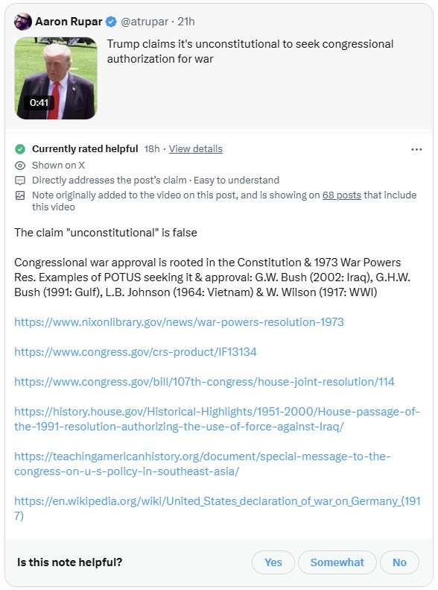
The Fix?

Slide 5
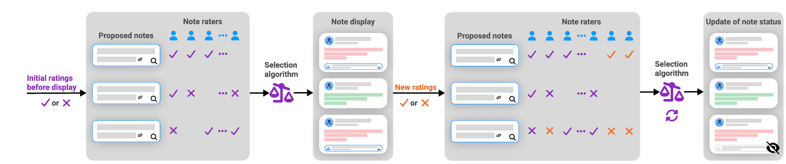
Community Notes
Every displayed note is the output of a rule that combines thousands of contributor ratings into one binary decision: display or don’t display
The rule is open-source, deployed at scale, and its inputs are public
This makes Community Notes a rare thing: a social choice mechanism we can study and test empirically

Slide 6


Four-Part Concept Puzzle – Slide Template
Fact-checking
Crowdsourcing
verifying and evaluating claims
Community-driven fact-checking
Aggregation rule
Bridging
how individual ratings become one displayed outcome
one specific aggregation rule: surface notes only when raters with opposing viewpoints agree
Notes:
© Copyright PresentationGO.com – Free Templates & Infographics for PowerPoint and Google Slides

Slide 7
Bridging ≠ Majority Rule
Majority rule | Bridging rule
Surface a note if >50% of raters find it helpful | Surface a note only if raters with opposing viewpoints agree it is helpful
Optimizes for: how many people agree | Optimizes for: agreement across the ideological groups; not legally protected subgroups
90 left-leaning (+) and 10 right-leaning (-) → shown | 90 left-leaning (+) and 10 right-leaning (-) → likely not shown (one-sided support)
Bridging encodes a normative claim that cross-viewpoint agreement is more legitimate than within-group consensus
However: Instrumental fairness for accurate, trusted fact-checks instead of towards participants

Slide 8
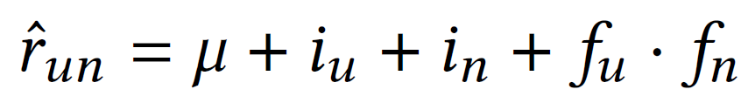
Basic Formula
r̂ᵤₙ = predicted rating by user u for note n
μ = general baseline helpfulness
iᵤ = user’s strict or generous rating tendency
iₙ = note’s general helpfulness tendency
fᵤ · fₙ = match between user viewpoint and note position

Slide 9
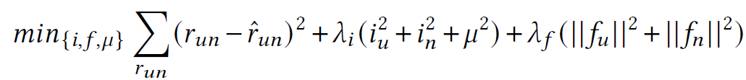
Basic Formula
Part 1: Σ(rᵤₙ − r̂ᵤₙ)² , accurate prediction of ratings
Part 2: λᵢ(iᵤ² + iₙ² + μ²), keeping intercepts small
Part 3: λf(‖fᵤ‖² + ‖fₙ‖²), absorbs viewpoint-aligned agreement
Part 2 = expensive (λᵢ = 0.15), Part 3 = cheap (λf = 0.03)
Genuine helpfulness vs. Viewpoint alignment
iₙ = helpfulness after viewpoint is factored out
needs to reach certain threshold to be displayed

Slide 10
Research Gap
Prior Research has shown effectiveness of the algorithm
Gap: post-display dynamics

Slide 11
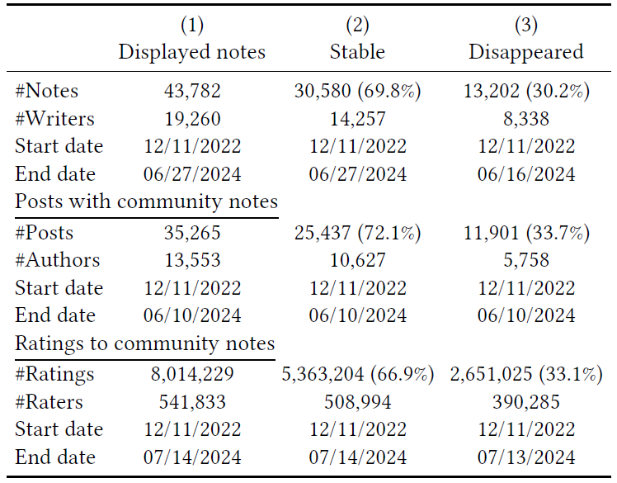
Dataset
from November 11, 2022, to July 14, 2024
437,396 Community notes
35,081,488 Ratings
583,285 Raters
233,908 Source Posts

Slide 12
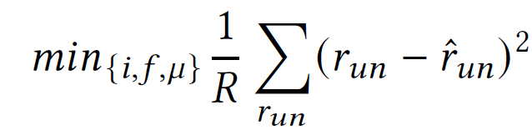
Rater Similarity
Purpose: factor the bridging logic into the analysis
Method: estimate latent rater viewpoints from past ratings
Model Extension: from 1 dimension in the original algorithm to 200 dimensions in this study
Adapted Loss function:
Groups: Similar (> 0.136), Dissimilar (< -0.097), General

Slide 13
Rater Groups
Subgroups here are inferred behavioral proxies, derived from rating history
The data contains no legally protected attributes (race, gender, age)
Fairness claims in this paper are about ideological subgroups, not protected groups

Slide 14
Multi-step Approach
RQ1: How often do displayed notes disappear?
RQ2: Which post and author characteristics predict disappearance?
RQ3: How do rating count and rating leaning change after display?
RQ4: Do similar and dissimilar raters behave differently after display?

Slide 15
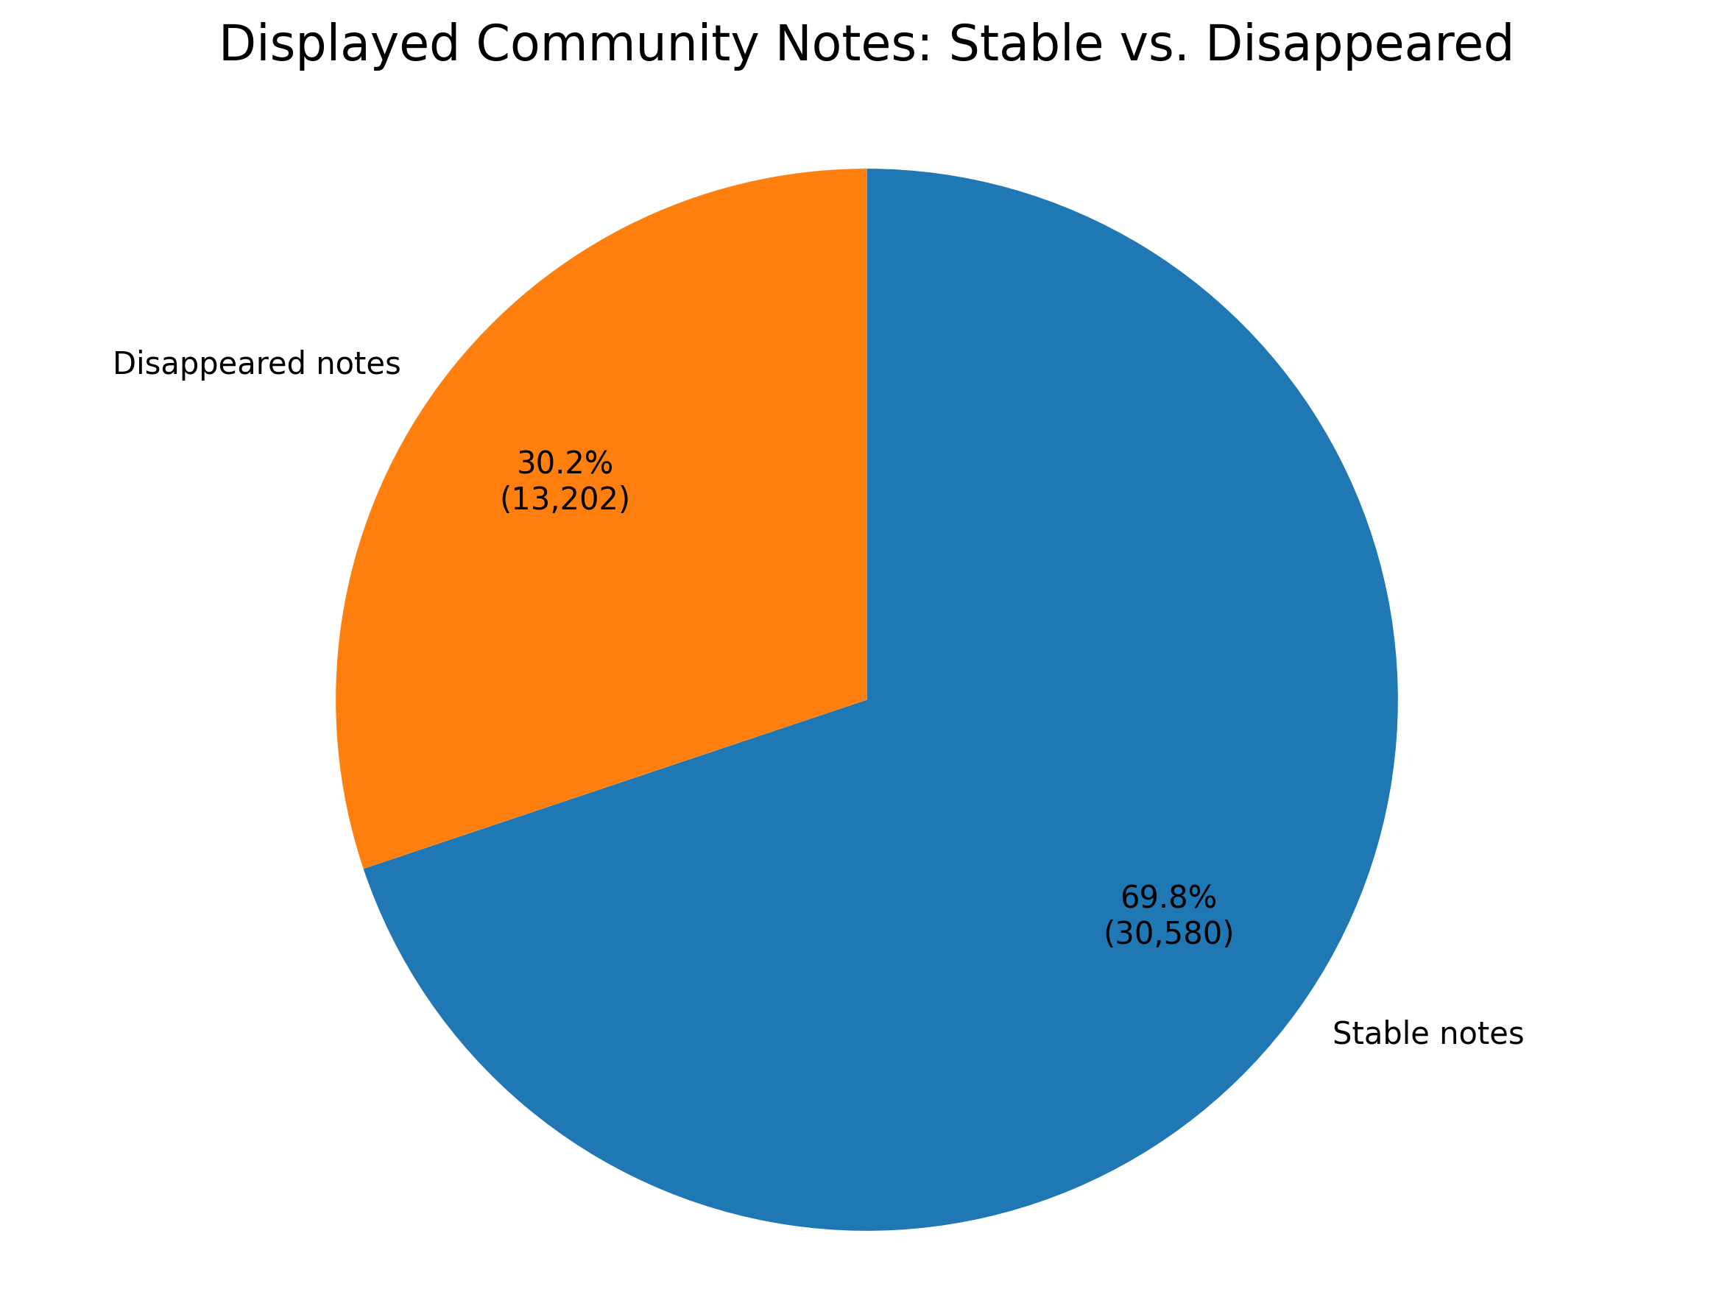
RQ 1: How often do displayed notes disappear?
Method: descriptive statistics
Findings:

Slide 16
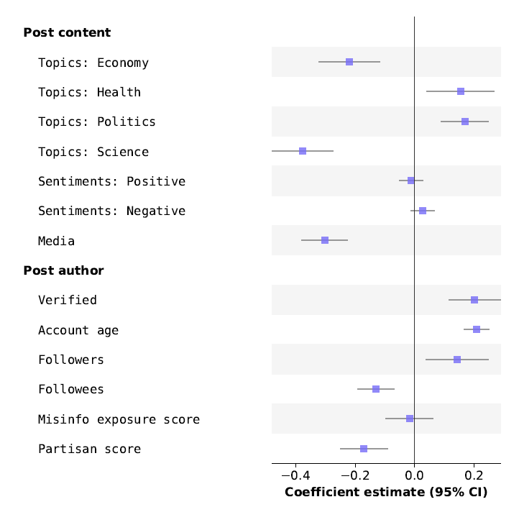

RQ 2: Which post and author characteristics predict disappearance?
Method: multilevel logistic regression model:
$logit(P(Y_{ij}))=β_{0}+β_{1}^{′}X_{i}^{Post}+β_{2}^{′}X_{j}^{Poster}+u_{j}+v_{i(j)}$
Findings:

Slide 17
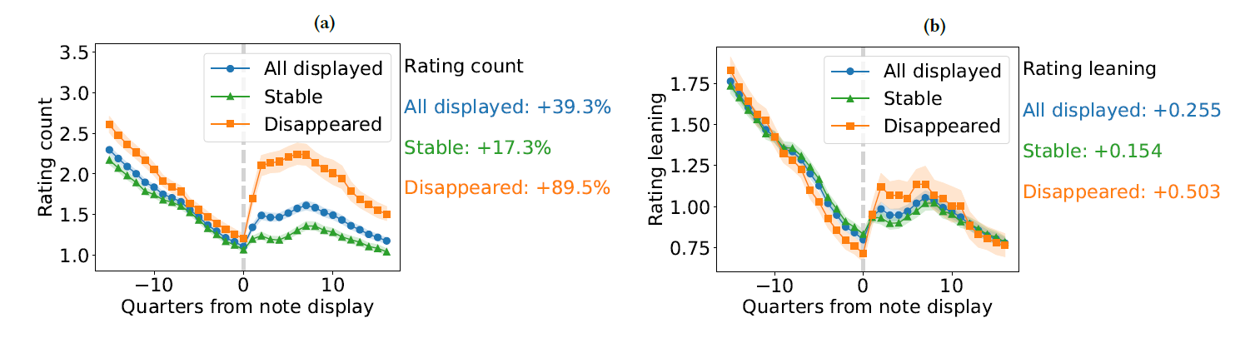

RQ 3: How do rating count and rating leaning change after display?
Method: interrupted time series model:
$Y_{i}=β_{0}+β_{1}T_{i}+β_{2}D_{i}+β_{3}\left(D_{i}×T_{i}\right)+γ_{i}+ε_{i}$
Findings:

Slide 18
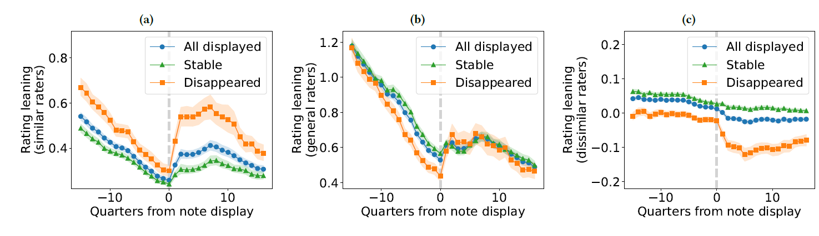

RQ 4: Do similar and dissimilar raters behave differently after display?
Method: interrupted time series model + rater similarity scores
$Y_{i}=β_{0}+β_{1}T_{i}+β_{2}D_{i}+β_{3}\left(D_{i}×T_{i}\right)+γ_{i}+ε_{i}$
Findings:

Slide 19
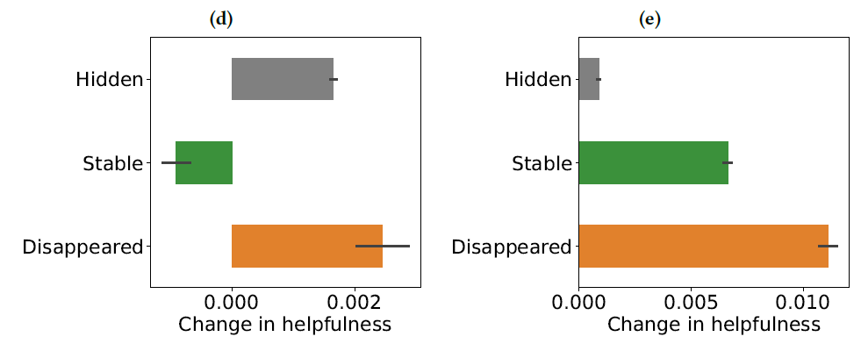
Counterfactual Analysis
Question: What would happen if we removed potentially polarized ratings?
Findings:

Slide 20
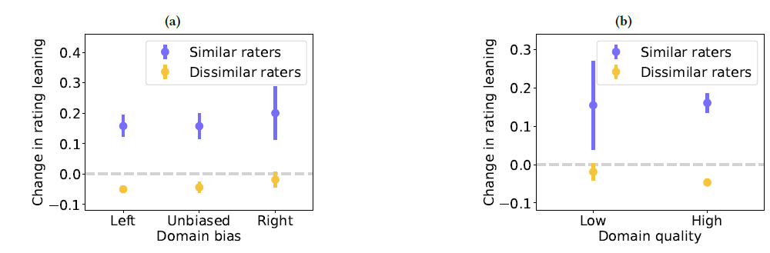
Effect of Source Characteristics
Question: How do source quality and ideological positioning shape rating behavior?
Findings:

Slide 21
Research Extension: Alternative Aggregation Rules
Why: The bridging algorithm is one aggregation rule among many. Each rule encodes a different normative claim about what "fair" aggregation means.
Test:
Re-run note selection on the same dataset under alternative rules:
1. simple majority (≥50% helpful)
2. supermajority (≥66%)
3. Group-balanced
4. Quality-weighted

Slide 22
Research Extension: Alternative Aggregation Rules
Test:
(i) which notes survive,
(ii) overlap with bridging outcomes,
(iii) which subgroups (left/right authors, high/low influence, topic categories) gain or lose representation.

Slide 23
Research Extension: Alternative Aggregation Rules
Value:
concretely shows the trade-offs between rules instead of arguing them abstractly
Directly operationalizes the question: What would it look like to optimize for something else?
Future research can evaluate whether other aggregation rules may yield better results for fact-checking and fairness

Slide 24
Research Extension: The Minority Veto Threshold
Dissimilar raters can flip outcomes, but the threshold is not clear
Test:
1. For each disappeared note determine the minimum share of dissimilar-rater downvotes needed to push the note below the display threshold
2. Plot the distribution of "veto thresholds."
3. Compare against the share of dissimilar ratings that actually arrived.

Slide 25
Research Extension: The Minority Veto Threshold
Value:
Turns the normative question into a measurable quantity.
A quantified median veto threshold of post-display ratings is a concrete, defensible fact about how the bridging rule weights minority influence.
Future research can test whether this threshold should be changed to increase the stability of accurate and trusted fact-checking

Slide 26
Research Extension: Pre-display selection bias
Community Notes raters are a self-selected group
Why: Post-display ratings may involve a different rater composition
Test: compare pre-display and post-display raters directly
Value: improves selection criteria for the Community Notes rating group

Slide 27
Research Extension: High-influence account effects
Notes on high-profile accounts disappear more often
Why: audience mobilization, visibility, or hidden rating dynamics
Test: cases with low similar/dissimilar rater disparity
Value: exposes possible bias and supports more transparent fact-checking

Slide 28
Discussion question #1:
“Is bridging protecting minority viewpoints, or giving them veto power? What should the system be optimizing ? consensus, minority protection, or viewpoint balance?”

Slide 29
Discussion question #2:
“Should AI support crowdsourced fact-checking by helping contributors find reliable sources, or would this create new risks of bias and overreliance on automated systems?”

Slide 30
Thank you
For Your Attention

